Slide 1
Java Basics
Università di Modena e Reggio Emilia
Prof. Nicola Bicocchi (nicola.bicocchi@unimore.it)

Slide 2
Building and running

Slide 3
Timeline
1991: SUN develops a language for cable TV boxes
1996: Java 1 (Netscape browser supports Java, popularity begins)
2005: Java 5 (major enhancements)
2014: Java 8 LTS (support until 2022)
2018: Java 11 LTS (support until 2023)
-- 6 months release cycle begins --
2019: Java 12, Java 13
2020: Java 14, Java 15
2021: Java 16, Java 17 LTS (support until 2026)
https://en.wikipedia.org/wiki/Java_version_history

Slide 4
JDK Enhancement Proposal
The JDK Enhancement Proposal (or JEP) is a process drafted by Oracle Corporation for collecting proposals for enhancements to the Java Development Kit and OpenJDK.
JEPs serve as the long-term Roadmap for JDK Release Projects and related efforts.
The JEP process is not intended to replace the Java Community Process, which is still required to approve changes in the Java API or language but rather to allow for OpenJDK committers to work more informally before becoming a formal Java Specification Request.
See https://openjdk.java.net/jeps

Slide 5
Features
Portable (Translated to bytecode)
Pure object-oriented
Statically typed
Garbage collected
Exceptions as a pervasive mechanism
Shares syntax elements w/ C++ (reduced learning curve)

Slide 6
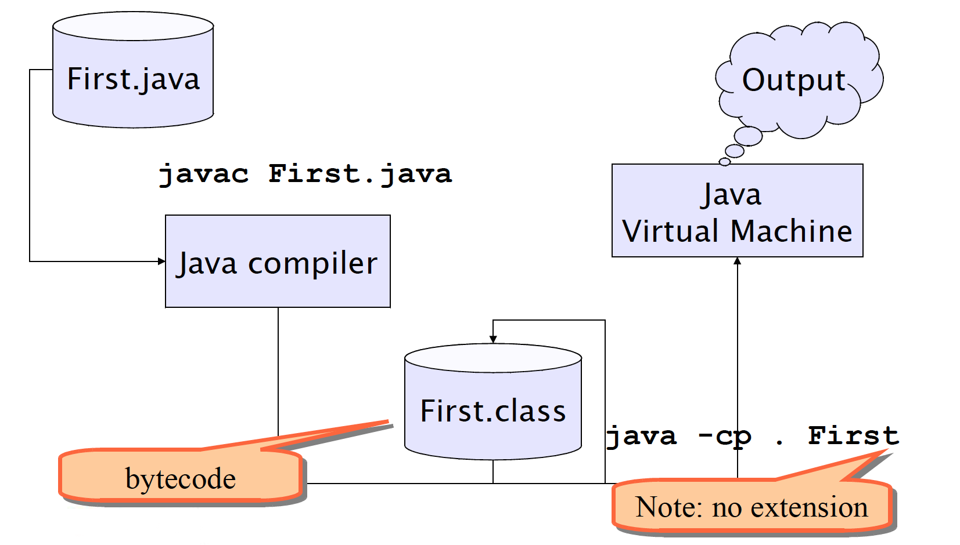
Building and running

Slide 7
Building and running
$ cd ooprogramming/java-code/src/main/java/it/oop/basics
$ javac ArraysUtils.java
(builds ArrayUtils.class. Unsuitable for large projects. Gradle uses build/ dir)
$ cd ooprogramming/java-code/build/classes/java/main
$ java -cp . it/oop/basics/ArraysUtils
v1 = [8, 8, 8, 8, 8, 8, 8, 8]
v1 = [79, 80, 70, 2, 86, 69, 32, 70]
v1 = [2, 32, 69, 70, 70, 79, 80, 86]
v2 = [2, 32, 69, 70, 70, 0, 0, 0]
$ javap -cp . -verbose it/oop/basics/ArraysUtils | grep major
major version: 61
(see https://en.wikipedia.org/wiki/Java_class_file#General_layout)

Slide 8
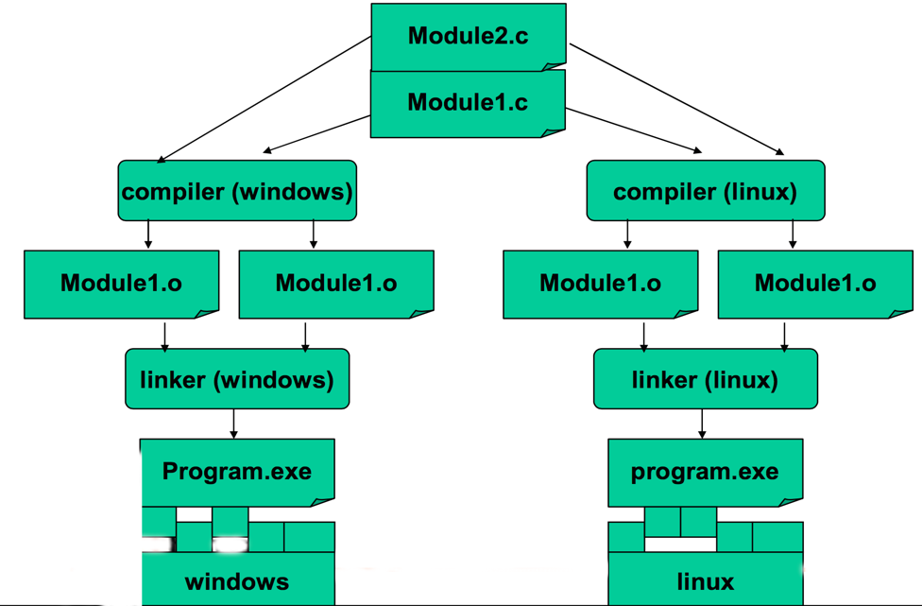
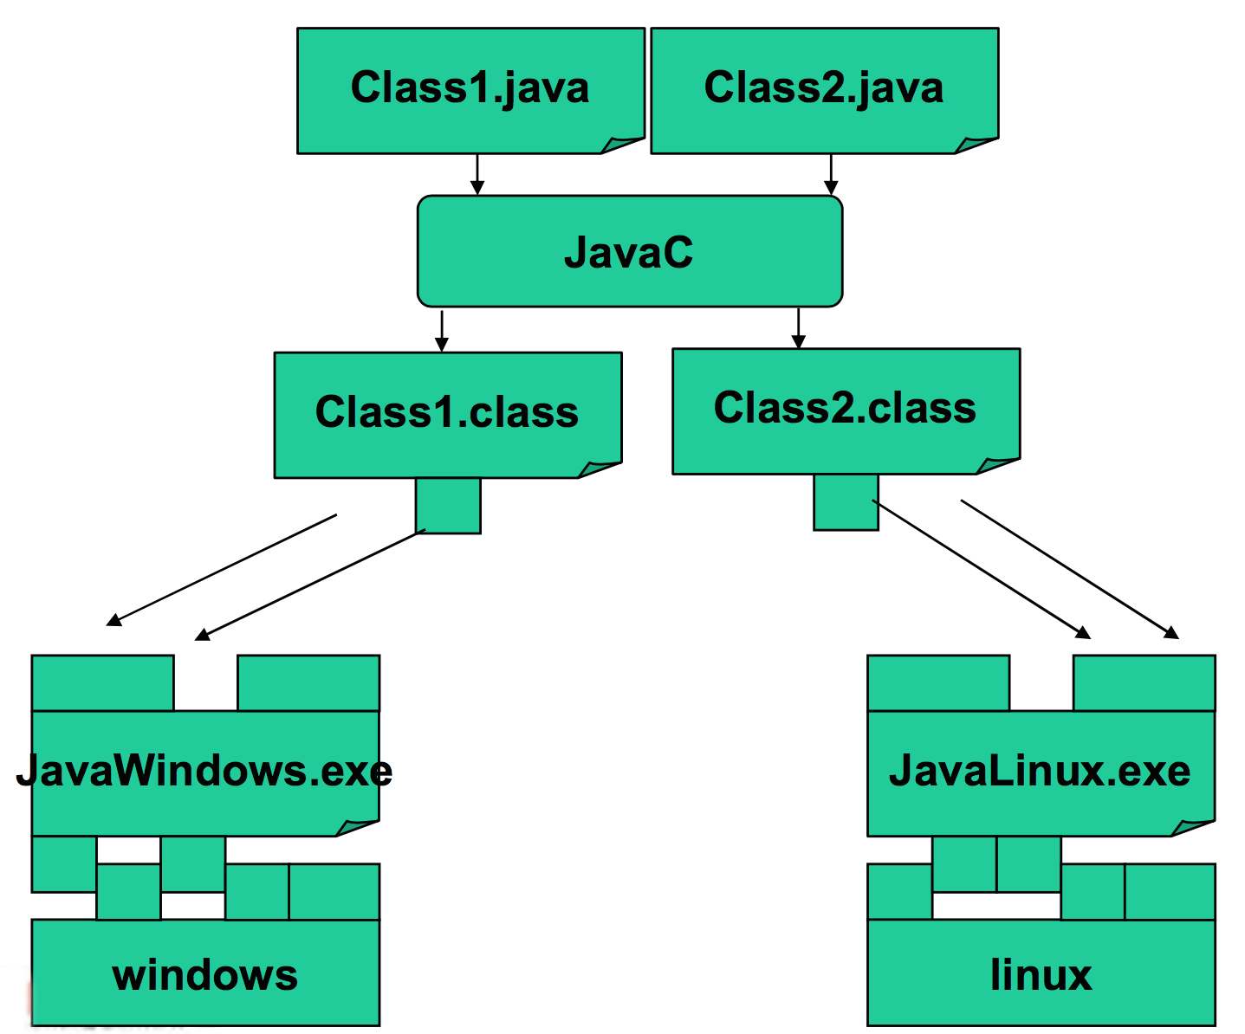
Compiled vs Interpreted
https://en.wikipedia.org/wiki/List_of_Java_virtual_machines

Slide 9
Variables, constants, conventions, methods

Slide 10
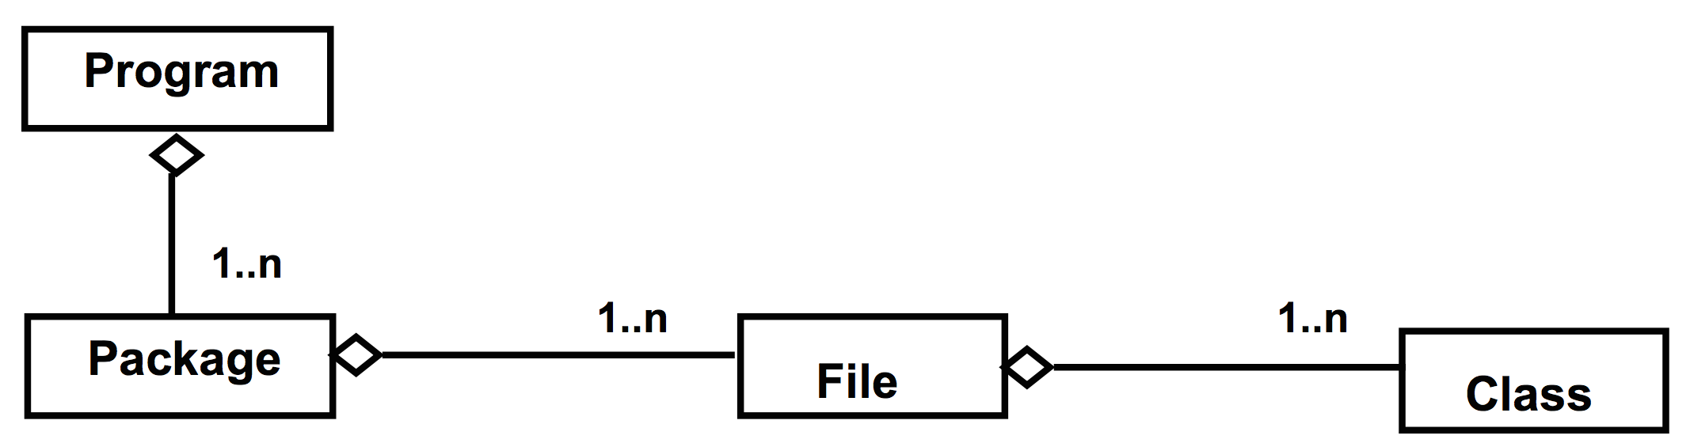
Program, files and classes
A program is made of one or more packages, containing one or more files
A file contains one public class and, optionally, multiple private classes. The file name must be equal to the public class name.

Slide 11
The main method
In Java there are no traditional functions, but methods within classes
The execution of a Java program starts from the main method:
public class Hello {
public static void main(String[] args) {
System.out.println(“Hello world!”);
}
}

Slide 12
Code blocks and Scope
Java code blocks are the same as in C
Each block is enclosed by braces { } and starts a new scope for the variables
Variables can be declared everywhere within a scope
for (int i = 0; i < 10; i++) {
int x = 12; ... int y;
...
}

Slide 13
Primitive types
public class PrimitiveTypes { public static void main(String[] args) { byte a = 13;
/* char is actually a 16 bit unsigned int */ char b = 65; short c = 34; int d = 332; long e = 122; float f = 7.6F; double g = 12.3; boolean h = true; } }
No native support for unsigned integer types
https://programming.guide/java/unsigned-int.html

Slide 14
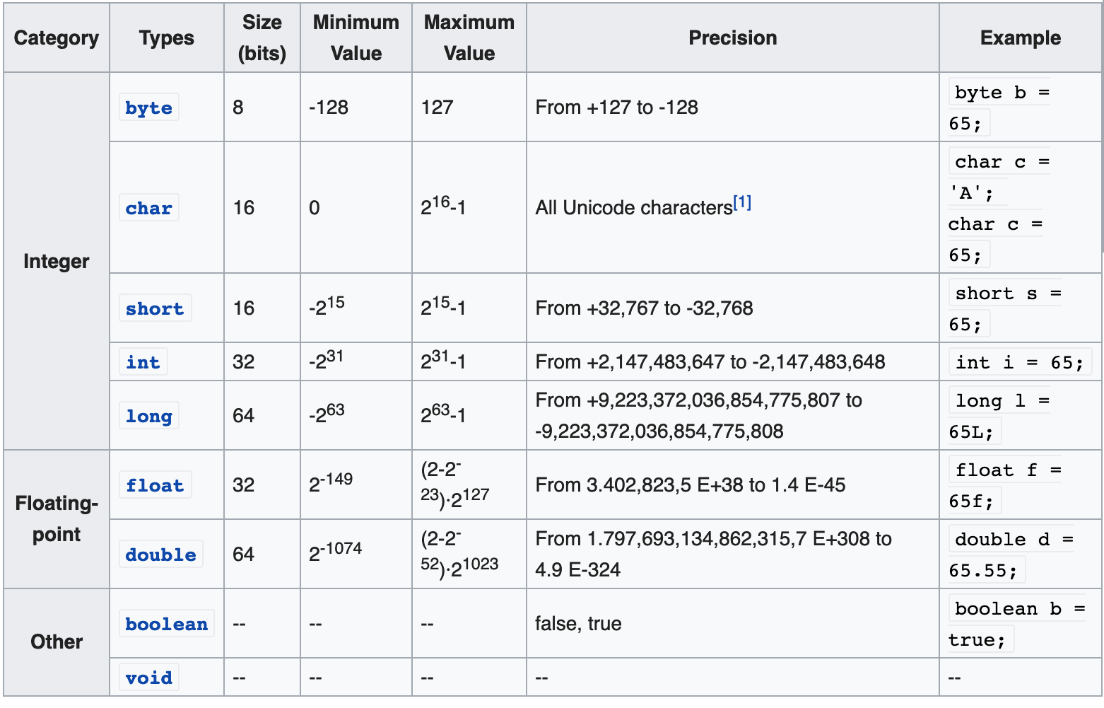
Primitive types

Slide 15
Literals
public static void main(String args[]) { int count = 987; int hexaVal = 0x7e4; int binary = 0b11010; int octalVal = 067;
long longVal = 123L; float floatVal = 4534.99f; double cost = 19765.567d; char alpha = 'p'; char ch1 = '\u0021'; char ch2 = 65; boolean boolVal = true; }

Slide 16
The var keyword
The var keyword was introduced in Java 10.
Type inference is used in var keyword in which it detects automatically the datatype of a variable based on the surrounding context. The below examples explain where var is used and also where you can’t use it.
// Java program to explain that
// var can used to declare any datatype
class Demo1 {
public static void main(String[] args)
{
// int
var x = 100;
// double
var y = 1.90;
// char
var z = 'a';
// string
var p = "tanu";
// boolean
var q = false;
}
}

Slide 17
The var keyword
// Java program to demonstrate that
// var cannot be used to declare
// instance and global variables
class Demo3 {
// instance variable
var x = 50;
public static void main(String[] args) {
System.out.println(x);
}
}
// Java program to demonstrate that
// var cannot be used as a Generic
// type
import java.util.*;
class Demo4 {
public static void main(String[] args) {
// Generic list using var
var<var> al = new ArrayList<>();
// add elements
al.add(10);
al.add(20);
al.add(30);
// print the list
System.out.println(al);
}
}

Slide 18
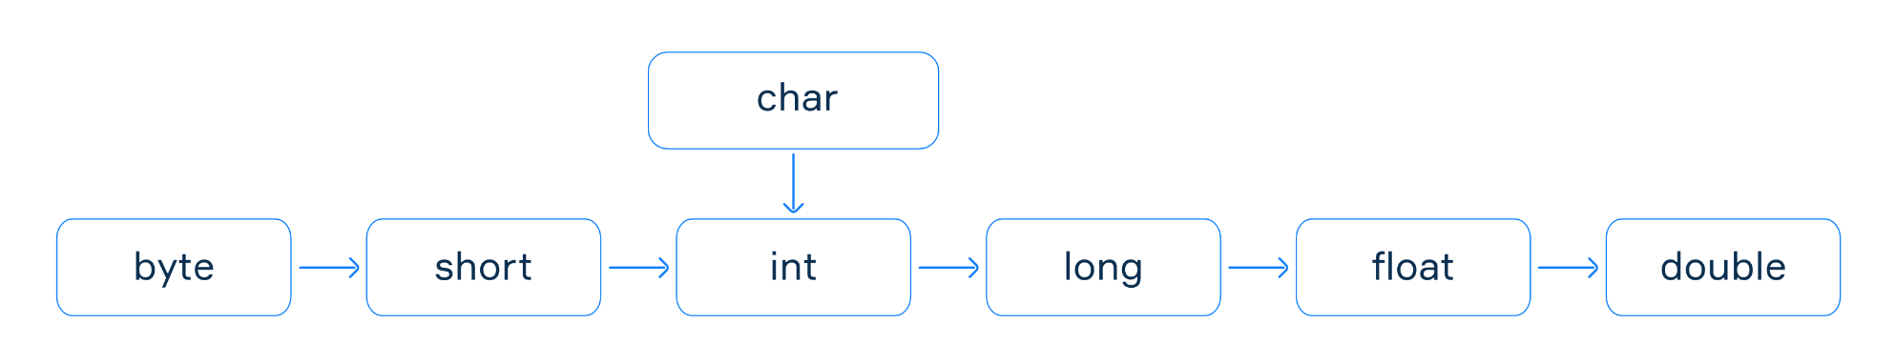
Implicit casting
The compiler automatically performs implicit casting when the target type is wider than the source type. The picture below illustrates the direction of this casting. Any value of a given type can be assigned to the one on the right implicitly or below in the case of char.
Normally, there is no loss of information when the target type is wider than the source type, for example, when we cast int to long. But it is not possible to automatically cast in the backward order (e.g. from long to int or from double to float).

Slide 19
Explicit casting
The considered implicit casting does not work when the target type is narrower than the source type. But programmers can apply explicit casting to a source type to get another type they want. It may lose information about the overall magnitude of a numeric value and may also lose precision.
double d = 2.00003;
// it loses the fractional part
long l = (long) d; // 2
// requires explicit casting because long is wider than int
int i = (int) l; // 2
// requires explicit casting because the result is long (indicated by L)
int val = (int) (3 + 2L); // 5
// casting from a long literal to char
char ch = (char) 55L; // '7'

Slide 20
Constants
A constant is a variable whose value cannot change once it has been assigned.
A constant can make our programs more easily understood by others.
Constants are cached by the JVM, so using constants might improve performance.
To define a variable as a constant, add the keyword final in front of its declaration.
final float PI = 3.1415F;
PI = 3.18; // ERROR, no changes allowed

Slide 21
Operators
Operators follow C syntax:
arithmetical + - * / %
Relational == != > < >= <=
bitwise & | ^ ! >> <<
Logical && || ! ^
Assignment = += -= *= /= %= &= |= ^=
Increment ++ --
Chars can be treated as integers (e.g. switch)
Logical operators work ONLY on Booleans
int is NOT considered a boolean value like in C

Slide 22
Reference Types
A reference is an entity that provides a way to access objects.
Generally, You can't access an object without a reference to it.
Point p = new Point(2,3);
p.getX();
p.magnitude();
String s = new String("Hello world!");
s.length()

Slide 23
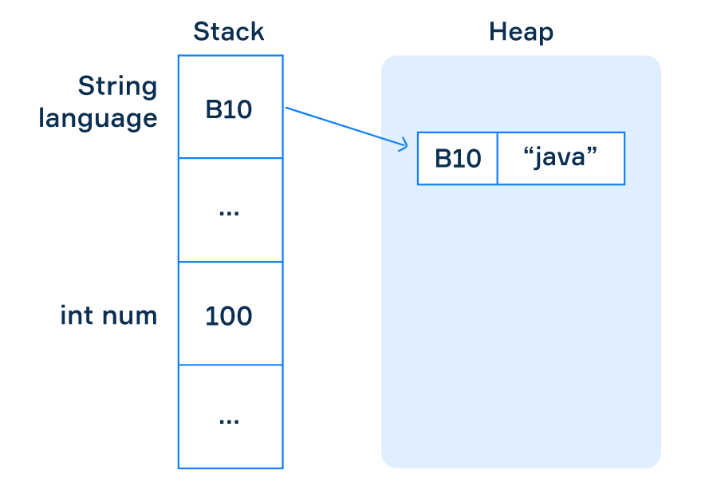
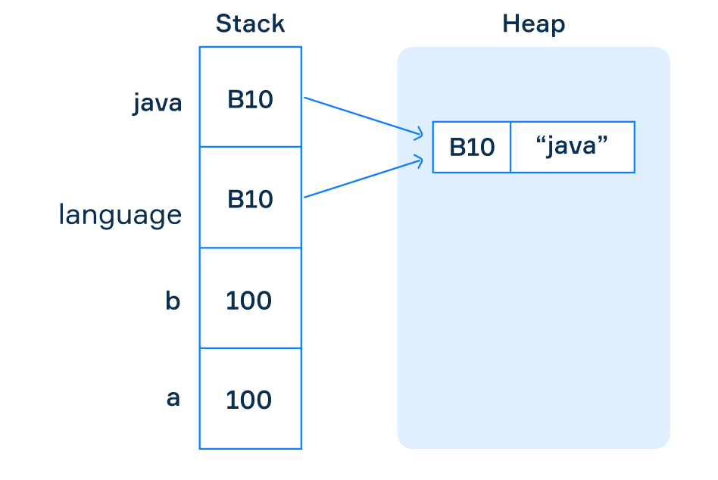
Primitive vs Reference Types

Slide 24
Reference Types
# C
typedef struct point { float x; float y; } point_t; point_t *allocate_point(float x, float y) { point_t *p = malloc(sizeof(point_t)); p->x = x; p->y = y; return p; } void free_point(point_t *p) { free(p); }
int main() { point_t *p = allocate_point(2, 3); printf("(%f,%f)\n", p->x, p->y);
free_point(p); }
# Java
public class Point { int x; int y; public Point(int x, int y) { this.x = x; this.y = y; } }
Public class Application {
public static void main(String[] args) { Point p = new Point(2, 3); System.out.printf("(%d, %d)\n", p.x, p.y); }
}

Slide 25
References and Objects
References are primitive variables and are stored in the stack memory
Objects are dynamically allocated (reside in the heap memory). Because of this, their lifecycle does not depend on any specific method’s lifecycle.
public class Test { public static Point allocatePoint(int x, int y) { return new Point(x, y); } public static void main(String[] args) { Point p = allocatePoint(2, 3); System.out.println(p); } }

Slide 26
Methods
Methods are blocks of code with a name that run when they are called
Methods are functions contained within a class
Methods receive parameters (many) and return values (one)
Java programs always start from a call to the main method
public class Test {
public static long method(int n) {
return n * n;
}
public static void main(String[] args) {
long n = method(20);
System.out.println(n);
}
}
// Outputs: 400

Slide 27
Passing Parameters (Primitive)
A method is a block of code with a name which only runs when it is called
They are used to perform certain actions, and they are equivalent to C functions
You can pass parameters to a method. Parameters can be primitive types or object references
Parameters are always passed by value (copy)
public class Parameters {
public static void swap(int a, int b) {
int tmp = a;
a = b;
b = tmp;
}
public static void main(String[] args) {
int a = 2;
int b = 3;
System.out.println(a); // 2
System.out.println(b); // 3
swap(a, b);
System.out.println(a); // 2
System.out.println(b); // 3
}
}

Slide 28
scambia()
main()
b=3
a=2
RA
Prima
tmp=2
b=2
a=3
RA
b=3
a=2
RA
Durante
b=3
a=2
RA
Dopo
addr=0
addr=1
addr=2
addr=3
addr=4
addr=5
addr=6
addr=7
addr=8
addr=9

Slide 29
scambia()
main()
b=3
a=2
RA
Prima
tmp=2
&b=5
&a=6
RA
b=3
a=2
RA
Durante
b=2
a=3
RA
Dopo
addr=0
addr=1
addr=2
addr=3
addr=4
addr=5
addr=6
addr=7
addr=8
addr=9

Slide 30
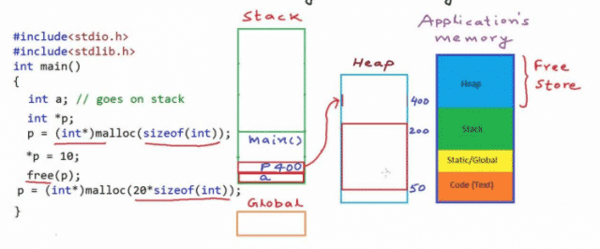
Passing Parameters (Primitive)
The Stack is the temporary memory where variables are stored while a function is executing. When the function finishes, the memory is cleared.
The Heap is a memory that the programmer can use for storing data whose lifecycle does not depend on any specific function.

Slide 31
Passing Parameters (Objects)
public class Parameters {
public static void main(String[] args) {
Point p1 = new Point(0, 0);
Point p2 = new Point(10, 10);
System.out.println(p1);
System.out.println(p2);
swap(p1, p2);
System.out.println(p1); // 0, 0
System.out.println(p2); // 10, 10
}
public static void swap(Point p1, Point p2) {
Point tmp = p1;
p1 = p2;
p2 = tmp;
}
}
main()
heap
swap()
p1
(0, 0)
p1
p2
(10, 10)
p2

Slide 32
Passing Parameters (Objects)
public class Parameters {
public static void main(String[] args) {
Point p1 = new Point(0, 0);
Point p2 = new Point(10, 10);
System.out.println(p1);
System.out.println(p2);
move(p1, p2);
System.out.println(p1); // 10, 10
System.out.println(p2); // 0, 0
}
public static void swap(Point p1, Point p2) { int tmpX = p1.x; int tmpY = p1.y; p1.x = p2.x; p1.y = p2.y; p2.x = tmpX; p2.y = tmpY; }}
main()
heap
swap()
p1
(0,0) -> (10, 10)
p1
p2
(10, 10) -> (0, 0)
p2

Slide 33
Passing Parameters (Objects)
public class Parameters {
public static void main(String[] args) {
Point p1 = new Point(0, 0);
Point p2 = new Point(10, 10);
System.out.println(p1);
System.out.println(p2);
move(p1, p2);
System.out.println(p1); // 10, 10
System.out.println(p2); // 0, 0
}
public static void swap(Point p1, Point p2) { Point tmp = new Point(p1); p1.setLocation(p2); p2.setLocation(tmp); }
}
main()
heap
swap()
p1
(0,0) -> (10, 10)
p1
p2
(10, 10) -> (0, 0)
p2

Slide 34
Coding Conventions
class ClassName {
public final double PI = 3.14;
private int attributeName;
public void methodName {
int var;
if (var == 0) {
/* this is a comment*/
}
}
}
In IntelliJ: Code -> Reformat File…

Slide 35
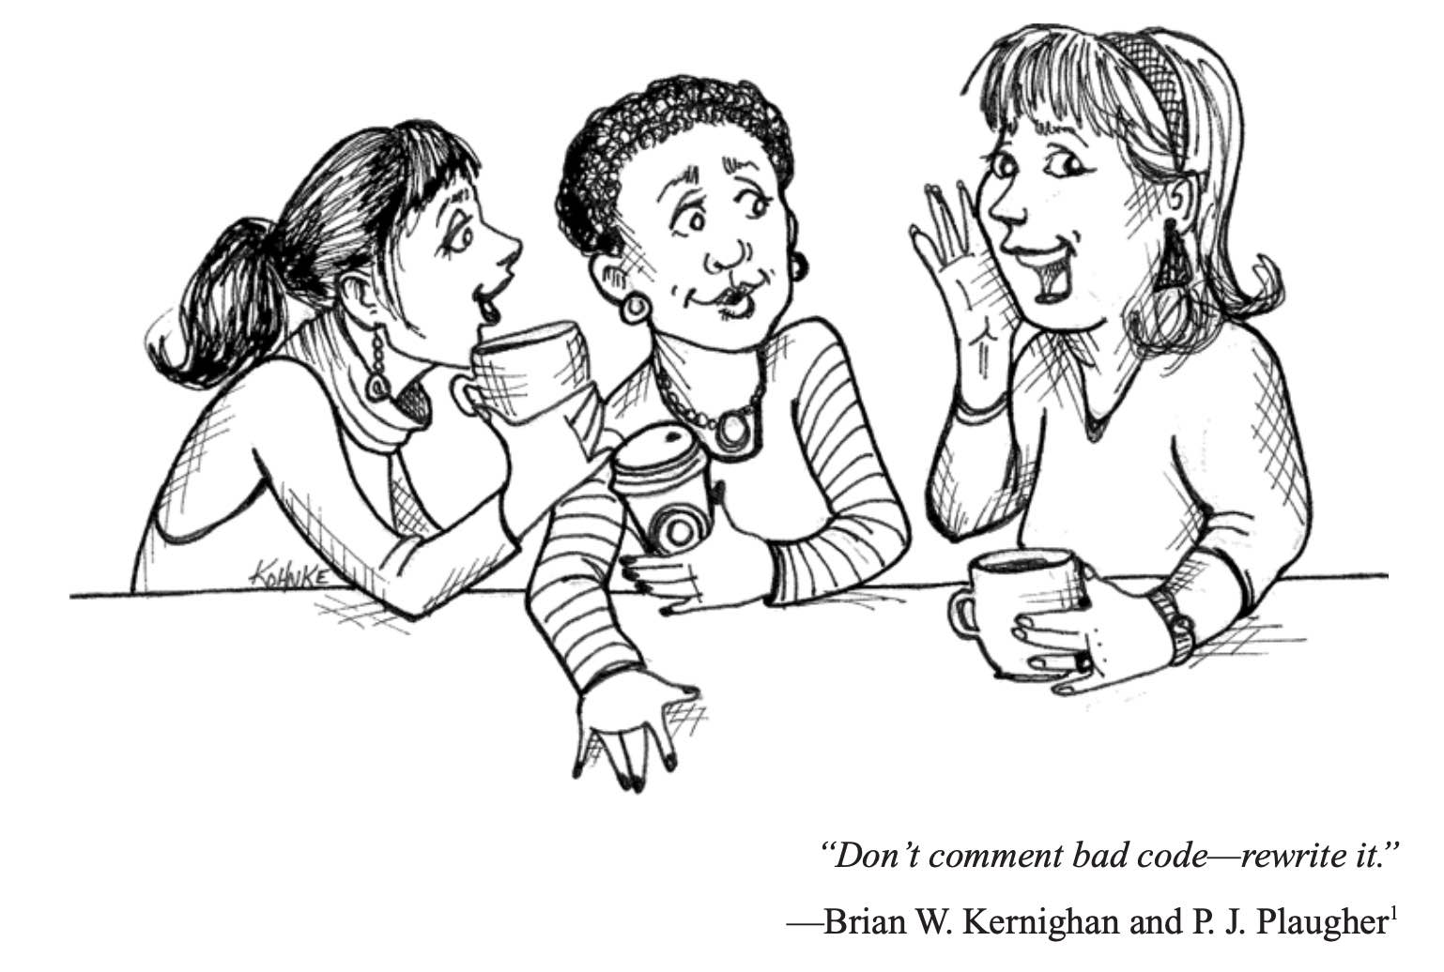
Comments
/*
* this comment is so long
* that it needs two lines
*/
// comment on one line
/**
* Set x, y, and z coordinates.
*
* @param x the x coordinate.
* @param y the y coordinate.
* @param z the z coordinate.
*/

Slide 36
Flow control statements

Slide 37
Flow control statements
Decision making statements
if statements
switch statement
Loop statements
do-while loop
while loop
for loop
for-each loop
Jump statements
break statement
continue statement

Slide 38
if statement
# Syntax
if (condition1) {
// executed if
// condition1 is true
} else if (condition2) {
// executed if
// condition1 is false and condition2 is true
} else {
// executed if
// condition1 is false and condition2 is false
}
# Example
int time = 22;
if (time < 10) {
System.out.println("Good morning.");
} else if (time < 20) {
System.out.println("Good day.");
} else {
System.out.println("Good evening.");
}

Slide 39
switch statement
# Syntax
switch(expression) {
case x:
// code block
break;
case y:
// code block
break;
default:
// code block
}
# Example
char grade = ‘B’;
switch(grade) { case 'A': System.out.println("Excellent!"); break; case 'B': case 'C': System.out.println("Well done"); break; case 'D': System.out.println("Danger zone"); break; default: System.out.println("Invalid grade"); }

Slide 40
switch statement (enhanced)
# Standard Switch
char grade = ‘B’;
switch(grade) { case 'A': System.out.println("Excellent!"); break; case 'B': case 'C': System.out.println("Well done"); break; case 'D': System.out.println("Danger zone"); break; default: System.out.println("Invalid grade"); }
# Enhanced Switch
switch (grade) { case 'A' -> System.out.println("Excellent!"); case 'B', 'C' -> System.out.println("Well done"); case 'D' -> System.out.println("Danger zone"); default -> System.out.println("Invalid grade"); }

Slide 41
do-while statement
# Syntax
do {
// code block to be executed
} while (condition);
# Example
int i = 0;
do {
System.out.println(i);
i++;
}
while (i < 5);

Slide 42
while statement
# Syntax
while (condition) {
// code block to be executed
}
# Example
int i = 0;
while (i < 5) {
System.out.println(i);
i++;
}

Slide 43
for statement
# Syntax (traditional)
for (statement 1; statement 2; statement 3) {
// code block to be executed
}
# Syntax (for-each)
for (type variableName : arrayName) {
// code block to be executed
}
# Example (traditional)
for (int i = 0; i <= 10; i++) {
System.out.println(i);
}
# Example (for-each)
String[] cars = {"Supra", "Lancer", "Impreza"};
for (String i : cars) {
System.out.println(i);
}

Slide 44
break/continue statements
The break statement can be used to jump out of a loop.
The continue statement breaks one iteration (in the loop), but continues with the next iteration instead of jumping out.
# Example (break)
for (int i = 0; i < 10; i++) {
if (i == 4) {
break;
}
System.out.println(i);
}
# Example (continue)
for (int i = 0; i < 10; i++) {
if (i == 4) {
continue;
}
System.out.println(i);
}

Slide 45
Array

Slide 46
Array
An array is an ordered sequence of variables of the same type which are accessed through an index
Can contain both primitive types or object references (not the actual objects!)
Array size must be defined at creation time (cannot change afterwards)
An array reference can be declared with one of these equivalent syntaxes
int[] v or int v[]
Point[] v or Point v[]
Declaration is not creation!
// declaration
int[] v;
int[] v = null;
// declaration and creation
int[] v = new int[256];
int[] v = {2,3,5,7,11,13};

Slide 47
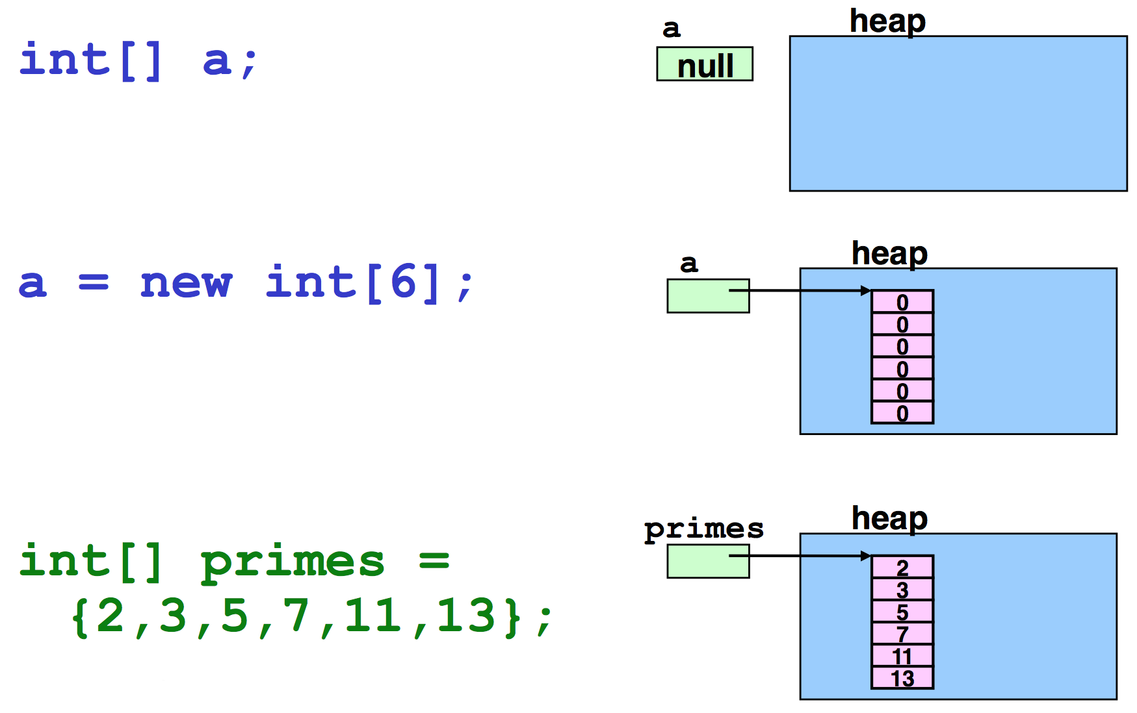
Example – Primitive types

Slide 48
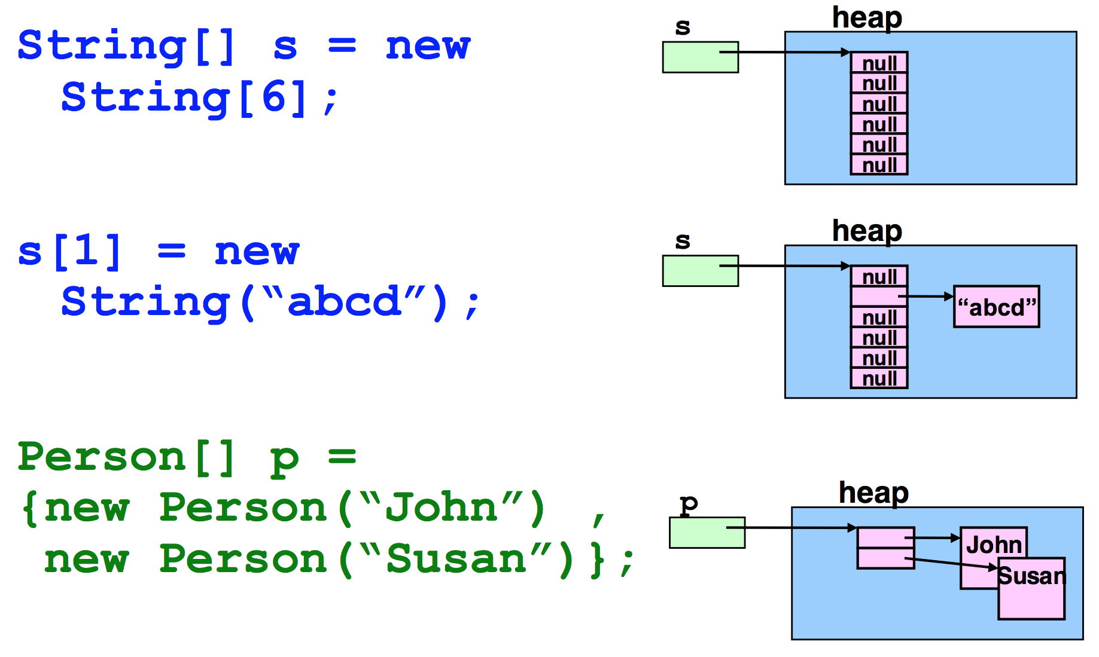
Example – Object reference

Slide 49
Operations on arrays
String[] args;
/* explicit index */
for(int i = 0; i < args.length; i++) {
System.out.println(args[i]); //...
}
/* implicit index
(also called for-each syntax) */
for(String arg: args) {
System.out.println(arg);
//...
}
Java checks array bounds at runtime
int[] v = new int[16]
System.out.println(v[20])
ArrayIndexOutOfBoundsException
The length of an array (the maximum capacity of the array) is provided by the attribute length.
Not to be confused with the method size() provided by the Collection interface!

Slide 50
Operations on arrays
An array reference is not a pointer to the first element of the array
It is a reference to the array object
Arithmetic on pointers does not exist in Java
// error!
int[] v1 = new int[16]; int[] v2 = v1 + 2;

Slide 51
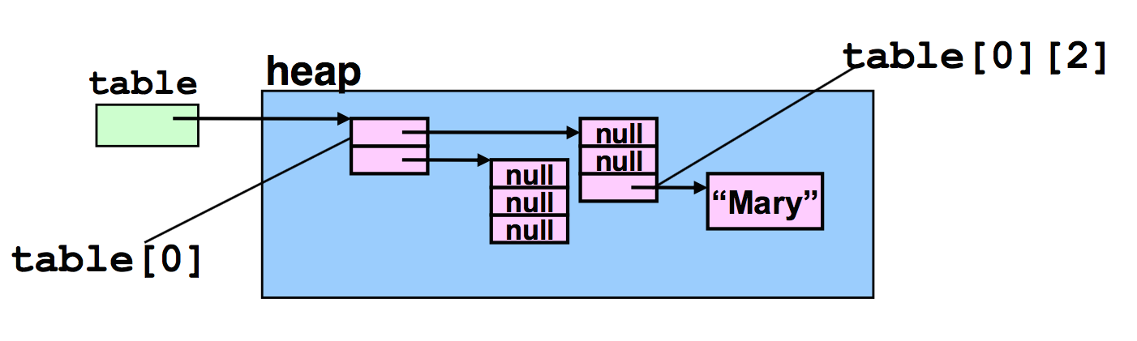
Multidimensional Arrays
String[][] table = {{"a", "b", "c"}, {"d", "e", "f"}}; System.out.println(Arrays.deepToString(table)); // switching rows only requires switching references
String[] tmp = table[0]; table[0] = table[1]; table[1] = tmp; System.out.println(Arrays.deepToString(table));

Slide 52
java.util.Arrays
Alter-ego of java.util.Collections for arrays
This class contains various methods for manipulating arrays such as sorting, searching, filling, printing or being viewed as Collections
asList()
binarySearch()
sort()
fill()
toString()
deepToString()

Slide 53
System.arraycopy()
System.arraycopy() copies an array from the specified source array, beginning at the specified position, to the specified position of the destination array. The number of components copied is equal to the length argument.
Advised because simple and fast!
public static void arraycopy(
Object src, int srcPos,
Object dest, int destPos,
int length)
int[] v1 = new int[8]; int[] v2 = new int[8]; Arrays.fill(v1, 10); Arrays.fill(v2, 12); // manual array copy
// System.arraycopy(v1, 0, v2, 4, 4); for (int i = 0; i < 4; i++) { v2[i+4] = v1[i]; } System.out.println(Arrays.toString(v1)); System.out.println(Arrays.toString(v2));

Slide 54
Example
public static void main(String[] main) {
Random rnd = new Random();
int[] v1 = new int[10];
int[] v2 = new int[10];
Arrays.fill(v1, 15);
System.out.println("v1 = " + Arrays.toString(v1));
for (int i = 0; i < v1.length; i++) {
v1[i] = rnd.nextInt(100);
}
System.out.println("v1 = " + Arrays.toString(v1));
Arrays.sort(v1);
System.out.println("v1 = " + Arrays.toString(v1));
System.arraycopy(v1, 0, v2, 0, 10);
System.out.println("v2 = " + Arrays.toString(v2));
}
v1 = [15, 15, 15, 15, 15, 15, 15, 15, 15, 15]
v1 = [37, 48, 19, 66, 18, 41, 8, 35, 44, 16]
v1 = [8, 16, 18, 19, 35, 37, 41, 44, 48, 66]
v2 = [8, 16, 18, 19, 35, 37, 41, 44, 48, 66]

Slide 55
Strings

Slide 56
String
In C char[] == string
char s[] = “literal”;
In Java char[] != String
More specifically, in Java, Strings are instances (objects) of a specific class (java.lang.String)
Strings are immutable objects
char[] s = {'h','e','l','l','o’};
String s = “hello”;
String s = new String(“Hello”);

Slide 57
Strings in memory
When created using String s = "something"; they are stored in a special pool in which the same string is stored only once
// memory use
String first = "Baeldung";
// no actual memory use
String second = "Baeldung";
// True
System.out.println(first == second);
When created using the new operator, Strings are stored in memory (heap) as standard objects
// memory use
String first = new String("Baeldung");
// memory use
String second = new String("Baeldung");
// memory use
String third = "Baeldung";
// False
System.out.println(first == second);
// False
System.out.println(first == third);

Slide 58
equals vs ==
The == operator verifies if two references point to the same object
The equals() method, instead, verifies if two objects (any object!) have the same internal state
String s1 = “hello”;
String s2 = ”hello”;
// true! Same object!
if (s1 == s2) { . . . }
// true
if (s1.equals(s2)) { . . . }
String s1 = new String(“hello”);
String s2 = new String(”hello”);
// false! Different objects!
if (s1 == s2) { . . . }
// true
if (s1.equals(s2)) { . . . }

Slide 59
String methods
charAt() Returns the character at the specified index (position)
compareTo() Compares two strings lexicographically
concat() Appends a string to the end of another string
contains() Checks whether a string contains a sequence of characters
endsWith() Checks whether a string ends with the specified character(s)
isEmpty() Checks whether a string is empty or not
length() Returns the length of a specified string
replace() Searches a string for a specified value, and returns a new string where the specified values are replaced
split() Splits a string into an array of substrings
startsWith() Checks whether a string starts with specified characters
substring() Returns a new string which is the substring of a specified string
valueOf() Returns the string representation of the specified value

Slide 60
The + operator
It is used to concatenate 2 strings
String s = “This string” + “is made by two strings”
Works also with other types (automatically converted to string)
System.out.println(“pi = ” + 3.14);
System.out.println(“x = ” + x);

Slide 61
StringBuilder
Being Strings immutable, when two Strings are concatenated using +, the two Strings are actually discarded and a new one (containing their concatenation) is instantiated.
This process is slow
StringBuilder provides a better way for concatenating Strings
public static void main(String[] args) {
// slow version
String s = "";
for (int i = 0; i < 100; i++) {
s += 'a';
}
System.out.println(s);
// fast version using StringBuilder
StringBuilder sb = new StringBuilder();
for (int i = 0; i < 100; i++) {
sb.append('a');
}
System.out.println(sb.toString());
}

Slide 62
Accessing Terminal

Slide 63
Standard files
System.in is an InputStream which is typically connected to keyboard input of console programs.
System.out is a PrintStream to which you can write characters. It normally outputs the data you write to it to the console / terminal.
System.err is a PrintStream. It works like System.out except it is normally only used to output error texts. Some programs (like Eclipse) will show the output to System.err in red text, to make it more obvious that it is error text.

Slide 64
PrintStream Methods
void print(String s)
Prints a string
void println(String s)
Prints a String and then terminate the line
void printf(String format, Object... args)
Write a formatted string using the specified format string and arguments
String String.format(String format, Object... args)
Returns a formatted string using the specified format string and arguments

Slide 65
Scanner
Scanner is a text scanner which can parse primitive types and strings using regular expressions.
Scanner breaks its input into tokens using a delimiter pattern, which by default matches whitespace.
The resulting tokens may then be converted into values of different types using the various next methods.
/* from stdin */
Scanner sc = new Scanner(System.in);
int i = sc.nextInt();
/* from a file */
Scanner sc = new Scanner(
new File("myNumbers"));
while (sc.hasNextLong()) {
long aLong = sc.nextLong();
}
/* using regular expressions */
String input = "1 fish 2 fish red fish blue fish";
Scanner s = new Scanner(input).useDelimiter("\\s*fish\\s*"); System.out.println(s.nextInt()); System.out.println(s.nextInt()); System.out.println(s.next());
System.out.println(s.next());
s.close();

Slide 66
Random Numbers

Slide 67
Random numbers
Math.random()
java.util.Random
Random random = new Random();
random.nextInt() [MIN_VALUE, MAX_VALUE]
random.nextDouble() [0, 1]
random.nextBoolean() [true, false]
java.util.random.RandomGenerator
RandomGenerator generator = RandomGenerator.getDefault();
RandomGenerator generator = RandomGenerator.of("L128X256MixRandom");
RandomGenerator generator = new Random();
java.util.concurrent.ThreadLocalRandom
ThreadLocalRandom.current().nextInt()
ThreadLocalRandom.current().nextDouble()
ThreadLocalRandom.current().nextBoolean()

Slide 68
Wisdom Pills
The first rule of functions is that they should be small. The second rule of functions is that they should be smaller than that. This is not an assertion that I can justify. I can’t provide any references to research that shows that very small functions are better. What I can tell you is that for nearly four decades I have written functions of all different sizes. I’ve writ- ten several nasty 3,000-line abominations. I’ve written scads of functions in the 100 to 300 line range. And I’ve written functions that were 20 to 30 lines long. What this experience has taught me, through long trial and error, is that functions should be very small. -- Clean Code, Robert C. Martin

